Slide 1
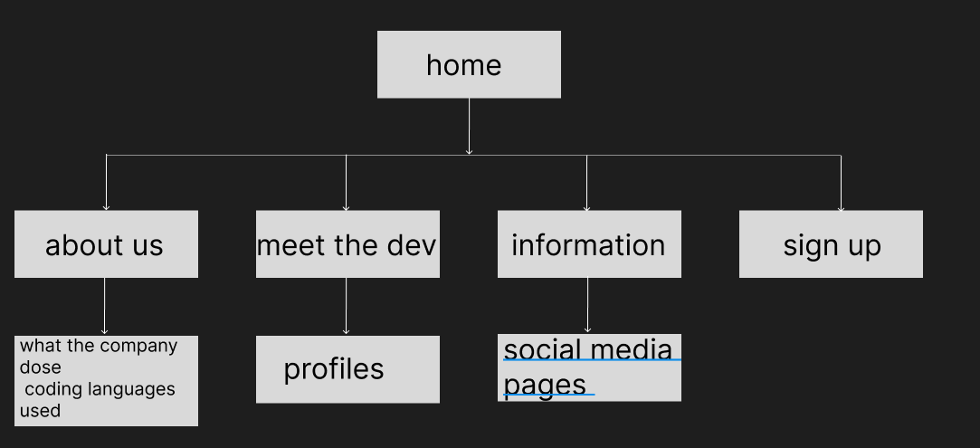

Slide 2
The home at the top will be used in a h1 tag the information will be from 16 - 25
The colours will be blues and are shown on the page bellow
The icons will be images of the logo of the app
HOME
HOME
ABOUT
DEVS
INFO
SIGN UP
Nav bar that directs to pages
INFORMATION
Margin: 15px
INFORMATION
Icon links
LINKS TO SOCIAL MEDIA
Padding: 10px each gap

Slide 3
ABOUT
HOME
ABOUT
DEVS
INFO
SIGN UP
INFORMATION
Sans serif
IMAGE
Image
INFORMATION
LINKS TO SOCIAL MEDIA

Slide 4
INFO
HOME
ABOUT
DEVS
INFO
SIGN UP
INFORMATION
Margin:15px
IMAGE
Margin: 18px
Image
INFORMATION
LINKS TO SOCIAL MEDIA

Slide 5
DEVS
HOME
ABOUT
DEVS
INFO
SIGN UP
DEV NAME
DEV INFORMATION
PHOTO OF DEV
Full profile
Links to the profile page
DEV NAME
DEV INFORMATION
INFORMATION
PHOTO OF DEV
Full profile
DEV NAME
DEV INFORMATION
PHOTO OF DEV
Full profile
Image
Link to their profile
LINKS TO SOCIAL MEDIA

Slide 6
SIGN UP
HOME
ABOUT
DEVS
INFO
SIGN UP
Sign up
First name
Text input
Surname
email
Submit details to form
Submit
LINKS TO SOCIAL MEDIA

Slide 7
HOME
Titel of each page
HOME
ABOUT
DEVS
INFO
Margin 15px
Padding 15 px
Div box
Div box
LINKS TO SOCIAL MEDIA

Slide 8
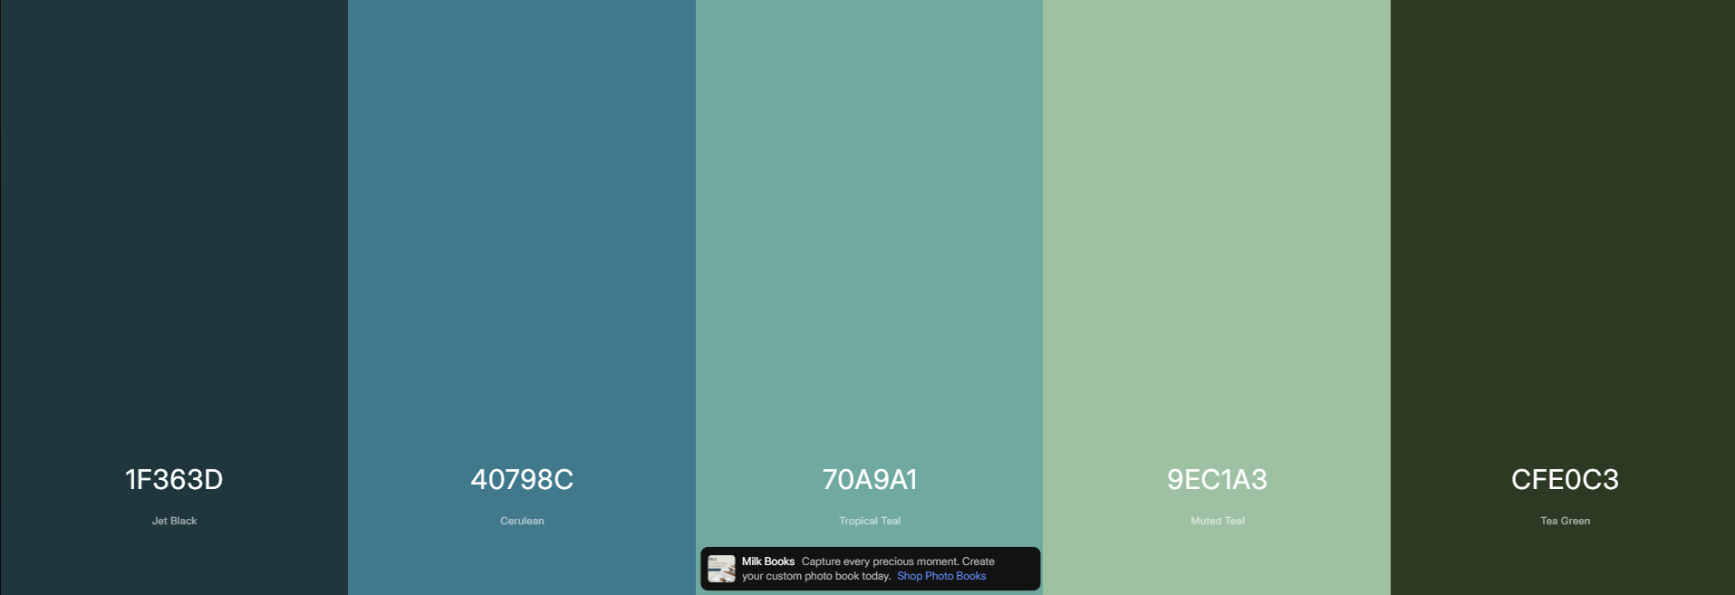
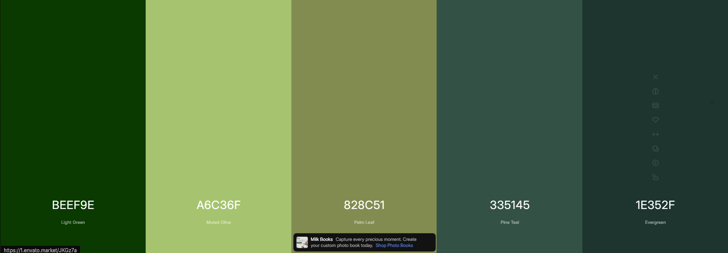

Slide 9
Justification
I have decided to make the fonts 16 – 25 and the font serif sans as at that size it will make It easier for the user to read the information and make it easier for the user to understand at a glance

